Slide 1


SERENITY FOUNDATION
PRESENTED BY-
NAIR SWAPNA SASIDHARAN (62)
AKSHAYA POOJA A P(14)
PARVATHY NAIR S (76)
GUIDE-
MRS. APARNA PV

Slide 2
TABLE OF CONTENTS
01
05
Diagrams (ER diagram,DFD,System Architecture)
About Our Project
02
06
Existing System and its demerits
Screenshots of Our System
03
07
Proposed System
Conclusion
04
08
Module Names and System Users
Scope for Further Development

Slide 3

ABOUT OUR PROJECT
The project seeks to develop a comprehensive software system designed to streamline the management of orphanages and elder care facilities. This system will serve as a centralized platform for handling various aspects of facility operations, including resident records, donation information, medical records, and educational records. By automating and organizing these tasks, the system aims to enhance efficiency, reduce administrative burdens, and ultimately improve the overall quality of care provided to residents.

Slide 4

EXISTING SYSTEMS AND ITS DEMERITS
In India, orphanages and elder care facilities currently utilize manual data management processes, relying on paper-based records and spreadsheets, which can lead to errors, inefficiencies, and scalability limitations. This approach hinders the generation of comprehensive reports and data analysis, ultimately impacting informed decision making. Furthermore, their online presence is often characterized by poor website design, outdated information, and a lack of empathy.
Demerits
- Error-prone and inefficient processes
- Limited scalability and reporting capabilities
- Inadequate data analysis and decision support
- Poor online presence and user experience
- Outdated and inaccurate information

Slide 5

PROPOSED SYSTEM
The proposed system will utilize advanced technologies to streamline processes, ensure data integrity, and augment operational efficiency. Key features include a unified database, automated workflow management, multilingual capabilities, and a user centric software solution. Furthermore, authorized users will have secure access to residents' medical and educational records, facilitating data-driven decision-making and enhanced care coordination.

Slide 6
MODULES
Signup
Login
Donation
Appointment
Record Request
Billing
USERS OF THE SYSTEM
User -the general public who can use the website.
Admin-the administrator who manages the facility.

Slide 7
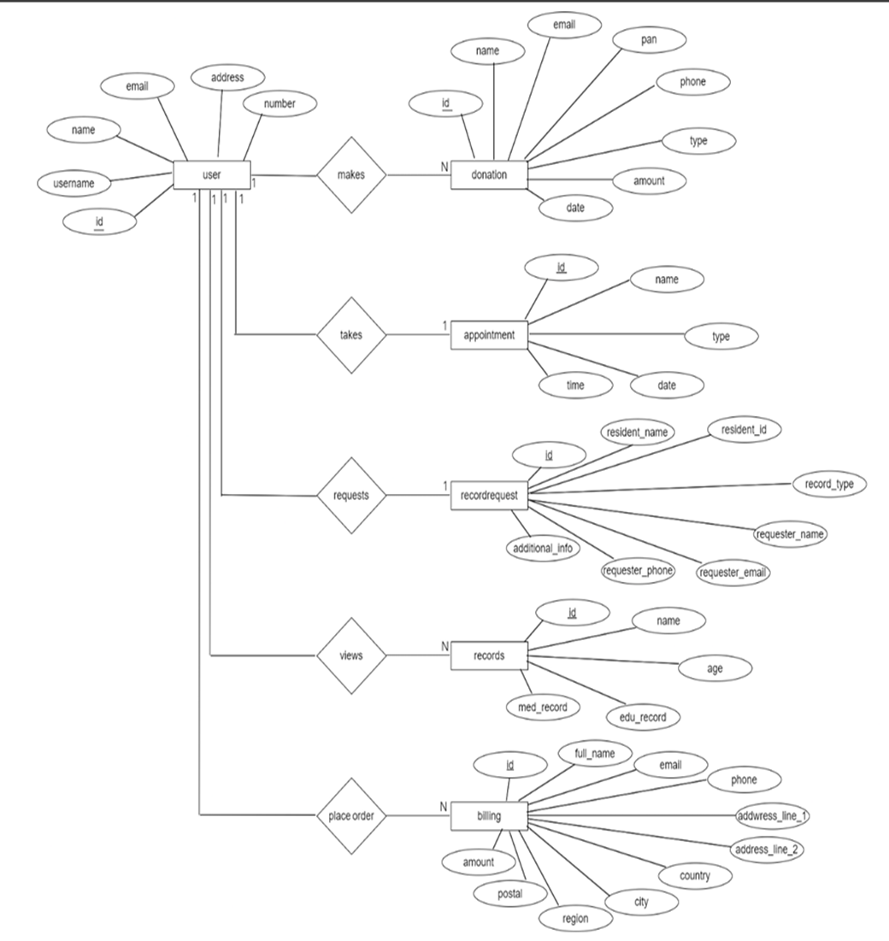
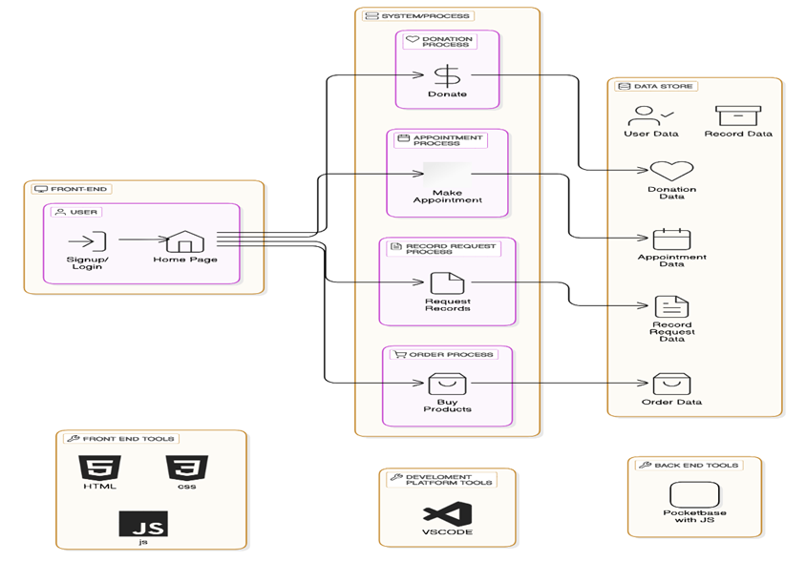
DIAGRAMS
ER DIAGRAM
SYSTEM ARCHITECTURE

Slide 8
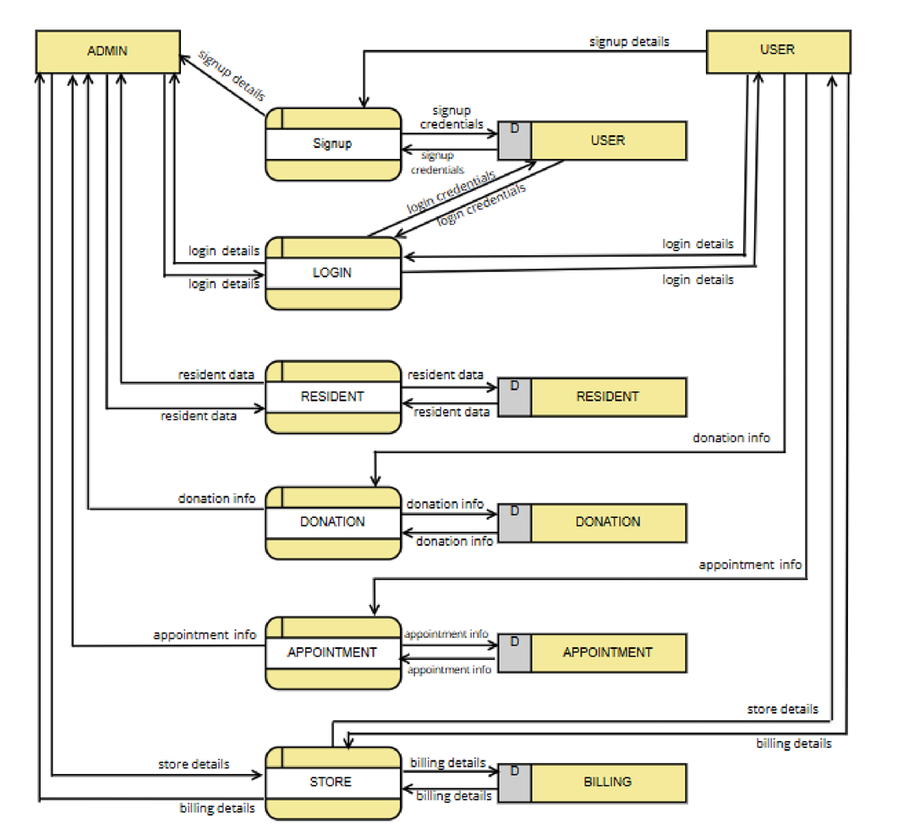
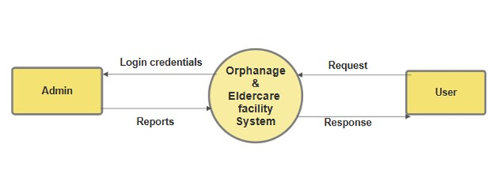
DFD
LEVEL 0
LEVEL 1

Slide 9
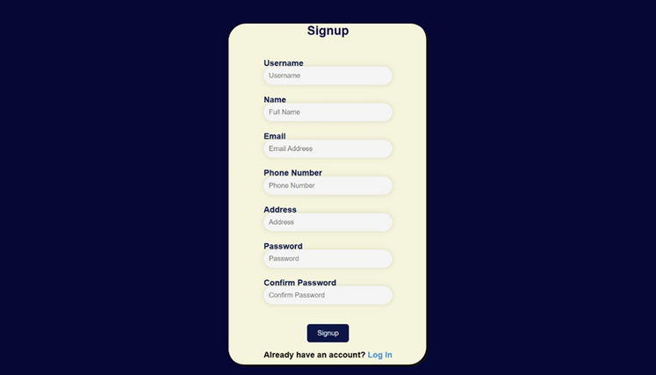
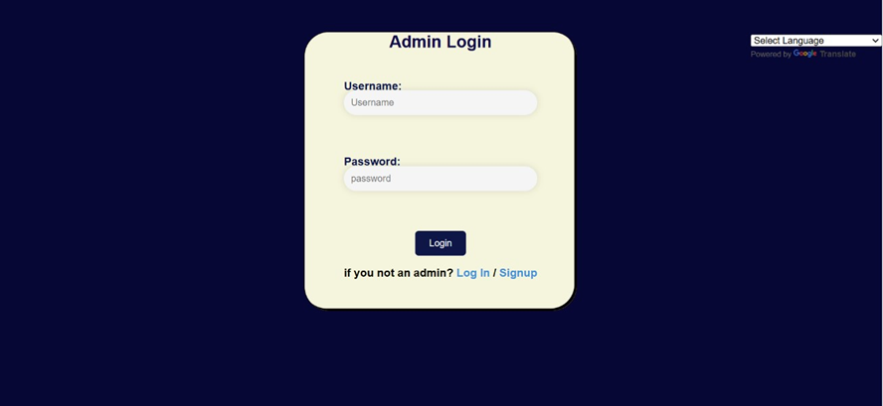
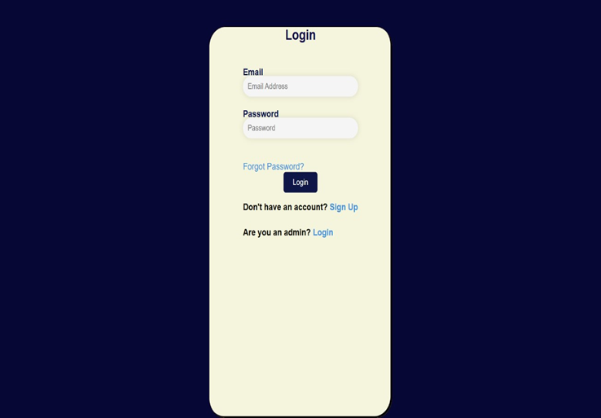
SCREENSHOTS
SIGNUP PAGE
LOGIN (ADMIN)
LOGIN PAGE

Slide 10
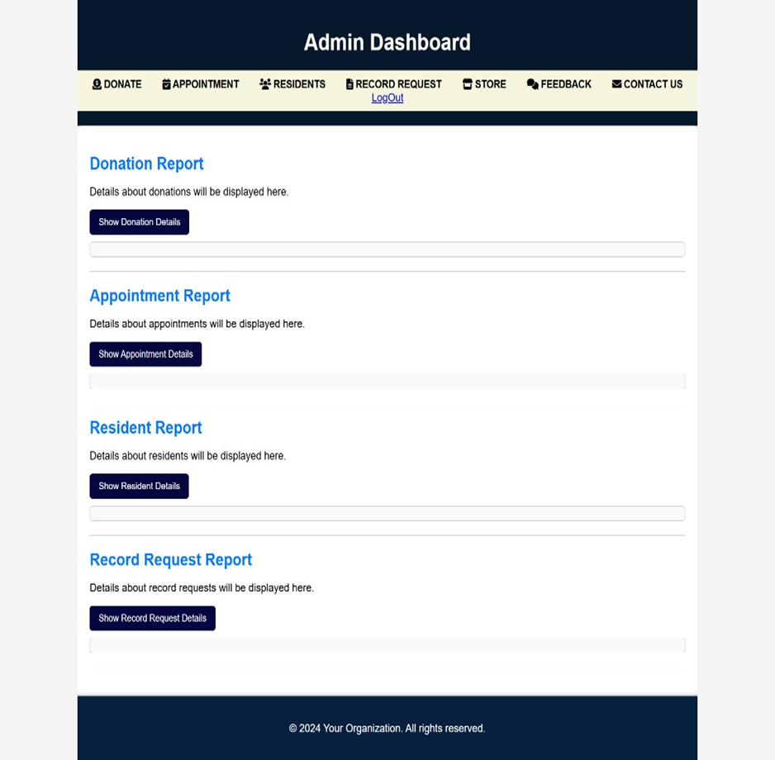
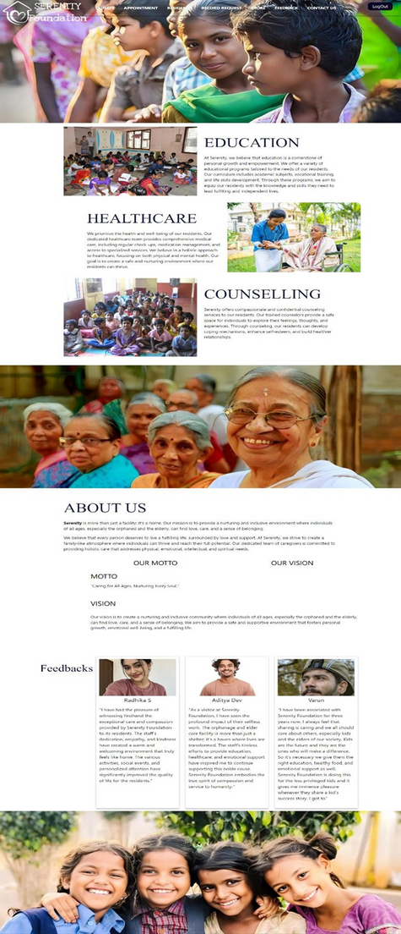
HOME PAGE
ADMIN DASHBOARD

Slide 11
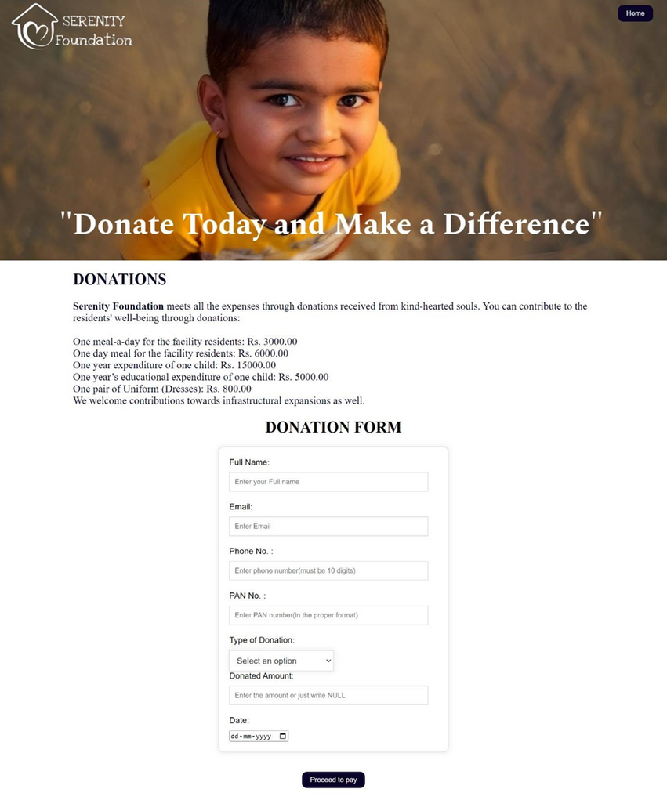
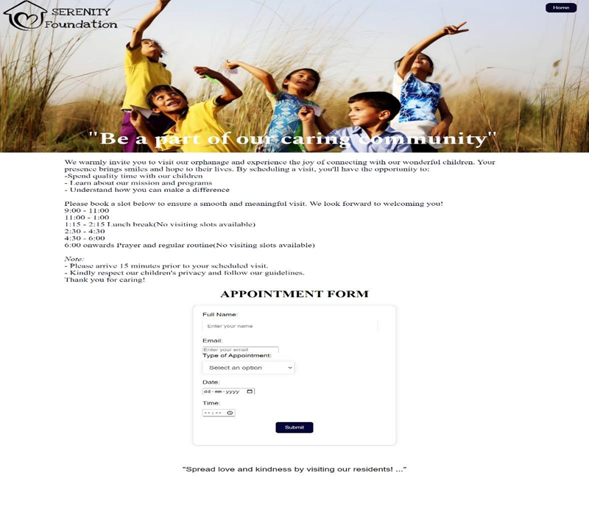
DONATION PAGE
APPOINTMENT PAGE

Slide 12
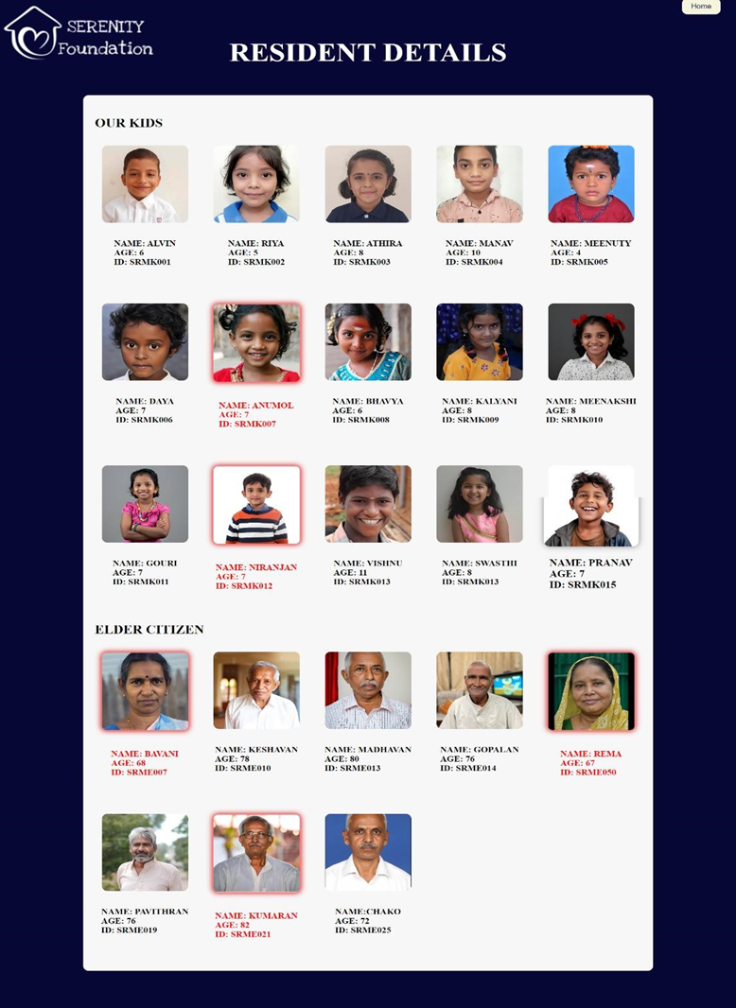
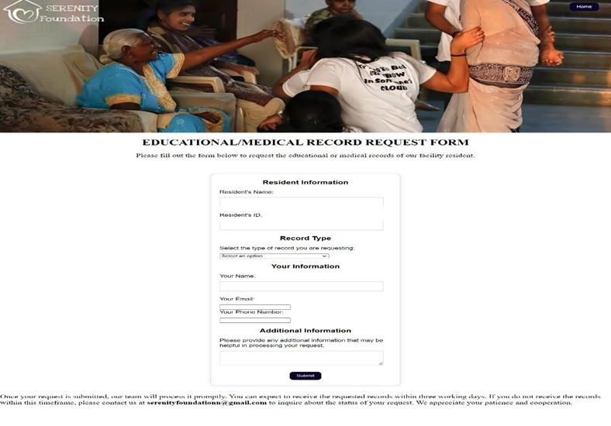
RESIDENT PAGE
RECORDREQUEST PAGE

Slide 13

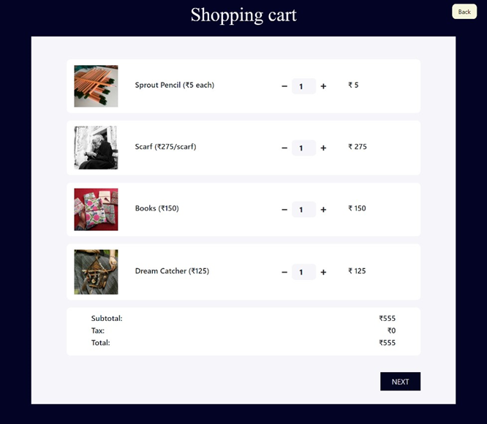
STORE PAGE
CART PAGE

Slide 14
CONCLUSION
The proposed integrated management system will significantly enhance the operations of the orphanage and elder care facility by streamlining processes, improving data management, and providing valuable insights. By addressing the limitations of manual systems, this solution will contribute to the overall well-being of residents and staff.
SCOPE FOR FURTHER DEVELOPMENT
•If this project is extended to further development, the new version can be implemented in the form of mobile application which can be easily accessible for staff and authorized family members.
•Launch targeted fundraising campaigns with social media and email integration, tracking progress and impact in real time.

Slide 15
Thank you

